Slide 1


Eventique
An AI-Enhanced Event Planning Web Application
Group 7 (Code Snap)​
Renugopal Sivaprakasam - (Lead) - 11699653 ​
Sparsha Dandganhalli Prakash - 11684265 ​
Soniya Kodipunjula - 11708235 ​
Govind Asawa - 11641270 ​
Usha Chandrashekar - 11722182 ​
Ruthvick Ravula - 11653170

Slide 2
Agenda
Project vision
Features
User Stories
Demo
Technical Stack Overview
Architecture
GitHub - Sprint Review
DevOps metrics
CI/CD
Conclusion

Slide 3
Product Vision
For anyone who is planning an event like a birthday party, wedding, or conference, the application, Eventique is a web app that works on a browser on any device. It uses artificial intelligence to supercharge your event planning in minutes with a recommender, scheduler, organizer, and notification system. Unlike other event management companies (such as Cvent, EventPro, and Bizzabo) which don’t have recommendation systems, are pricey and take a lot of time, our product provides a platform to design your event quickly in a way you would like within a few minutes.

Slide 4





Apt, real time adaptable recommender system to plan an event.
Ability to edit, delete or regenerate ideas for an event.
Features
Personalized suggestions made faster for a user.
One Stop solution to all event planners.

Slide 5







User Stories
Login/Signup
Plan Recommendation​
Approve/Regenerate Plan​
Calendar with navigation​
Editing Tasks from Calendar UI​
Filter Events​
Instant Task Creation​
View Events​
Notification​

Slide 6




Technical Stack Overview
1. Frontend - React.js
2. Backend - Django
3. Database - PostgreSQL
4. Integration with Gemini AI
5. Deployment and Operations: Containerization using Docker and Continuous Integration/Continuous Deployment (CI/CD)

Slide 7
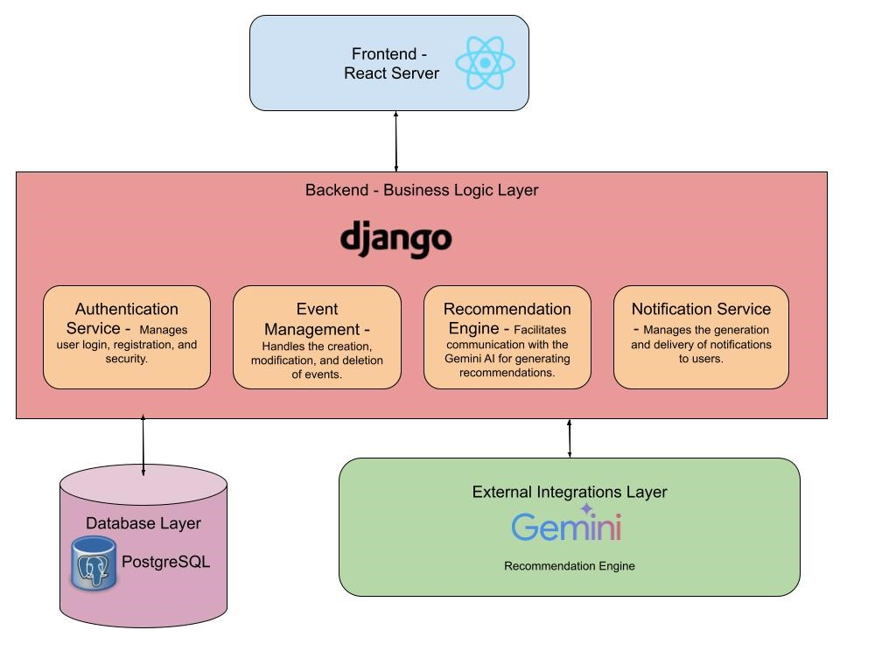
Software Architecture – Layered Architecture

Slide 8
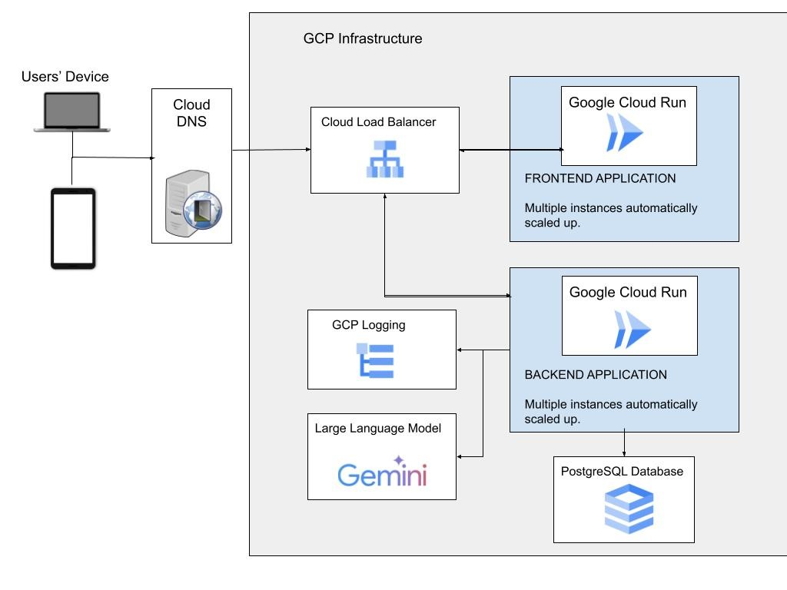
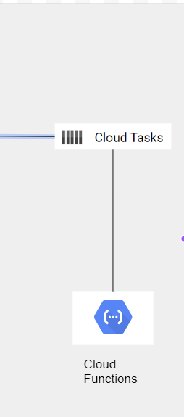
Cloud Infrastructure
Backend communicates with Frontend via Load Balancer (Nginx)

Slide 9
GitHub- Overview of the Sprints
GitHub Repository
Completion of the committed user stories
Sprint Overview
Logging pipeline setup
Setting up of the CI/CD Pipeline
Improvements worked upon- Better presentation during the sprint review call and the need to improve integration of frontend and backend tasks seamlessly.
Dockerizing the application
Successful Deployment

Slide 10





Process Measurement Metrics
DevOps Metrics
Deployment Frequency
Change Volume​
An average of 150 commits and 60 pull requests on GitHub
An average of about 20 deployments over the last 2 weeks
Mean Time to Recovery
Percentage of Failed Deployments
Lead Time
Deployment failure rate of 7%
Average time to recover service is- within 14 minutes
The average lead time- less than 10 minutes

Slide 11
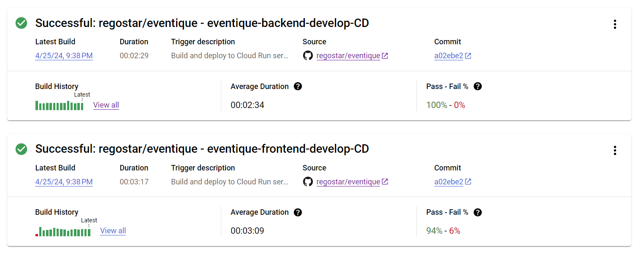
DevOps Metrics

Slide 12


CI/CD Pipeline
CI
SEMAPHORE TOOL
CD
Cloud Build
Build, Test, Linting, Generating Migration files, etc
Dockerize, ship and deploy on Cloud Run as soon as a pull request is merged into develop/main.

Slide 13
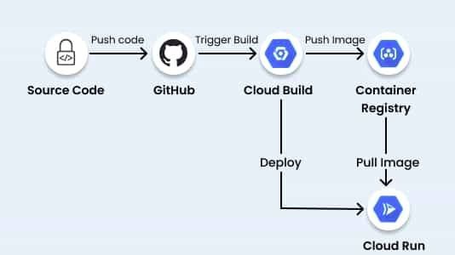
CI/CD Pipeline
This is the architecture is used for continuous deployment using GCP cloud run once the code gets merged into the main a build gets trigged.
During every pull request, the CI pipeline is automatically run. The unit tests are run and it outputs if it failed or succeeded. Test Build is also done.

Slide 14
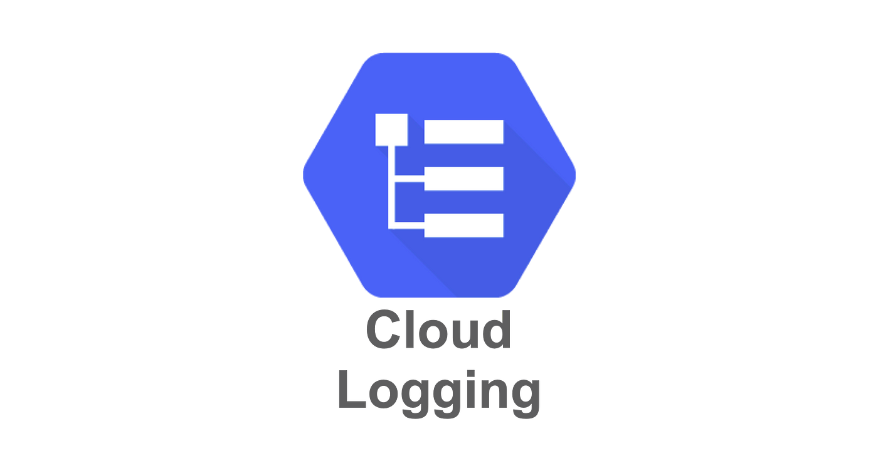

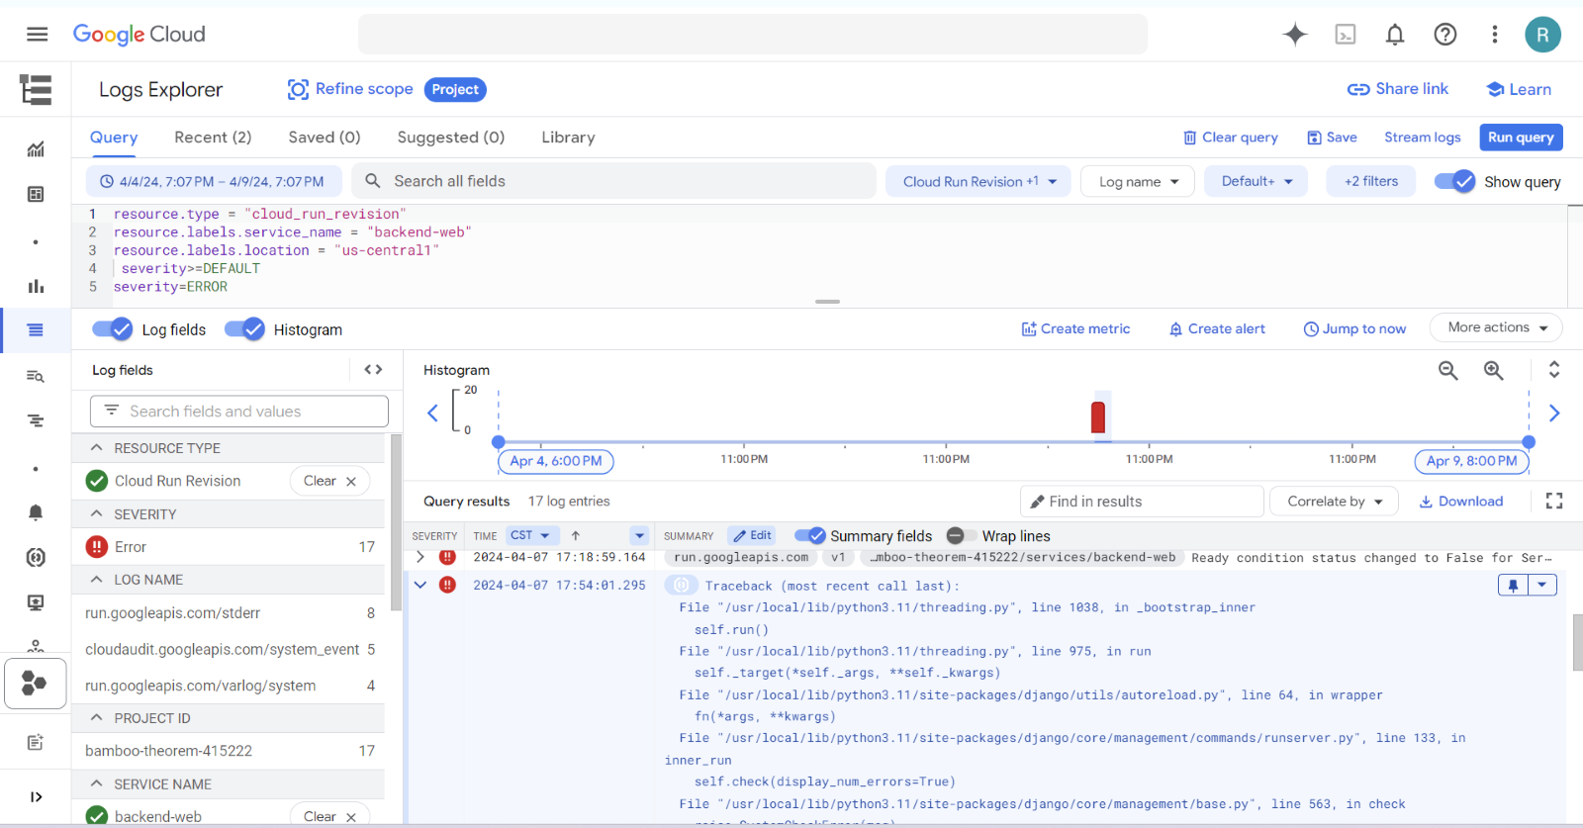
Logging
Utilized Google Logs Explorer to view App Logs
Utilized Cloudrun to see System Metrics for the instances we are running
Logging

Slide 15
Conclusion
Eventique: Your One-Stop Solution for Seamless Event Planning!
Leveraging AI
Seamless integration
Option 1
of events on a calendar
to empower users in creating memorable events effortlessly
Option 4
Option 2
Security, scalability, and performance
ensure a reliable and efficient experience for users
User-friendly interface
and customizable features
Option 3

Slide 16
Questionnaire
Questionnaire
Do you think you got to learn something valuable from this project?
What do you think of our project vision?
Rate our overall presentation.
Any suggestions? Please feel free to mention them!

